Slide 1
Sistemas Microcontrolados

Slide 2
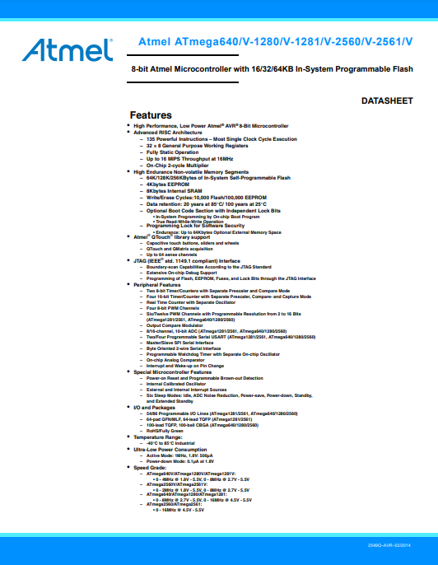
Datasheet

Slide 3
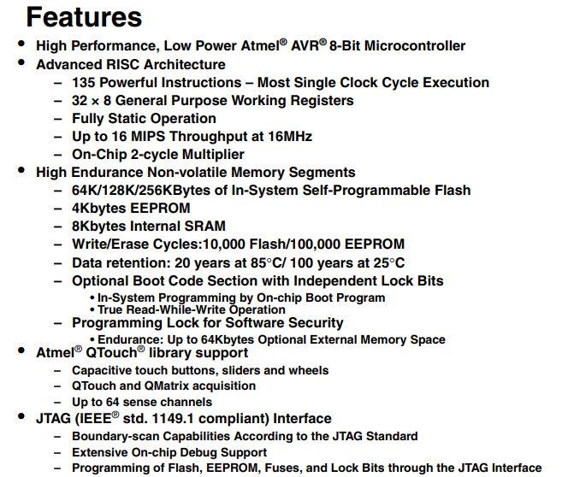
Datasheet

Slide 4
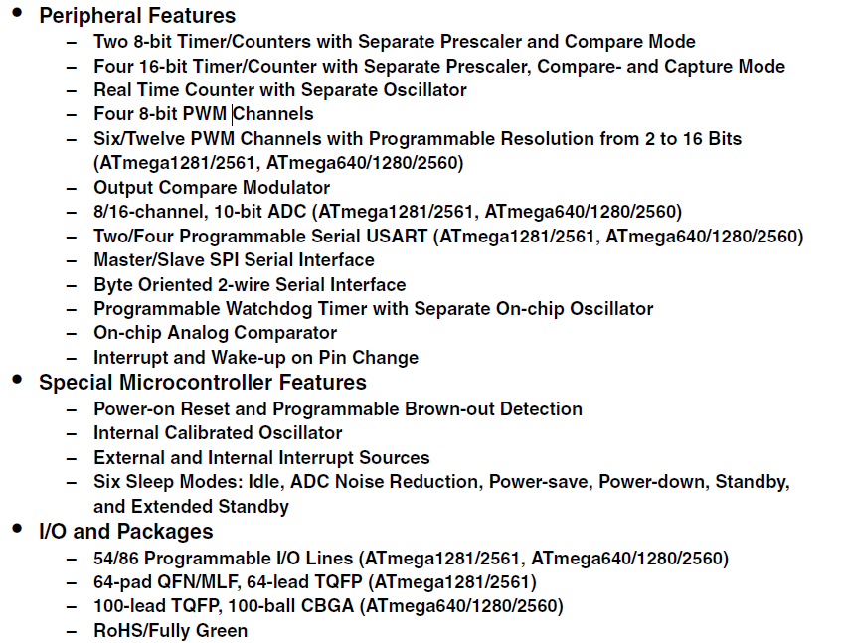
Datasheet

Slide 5
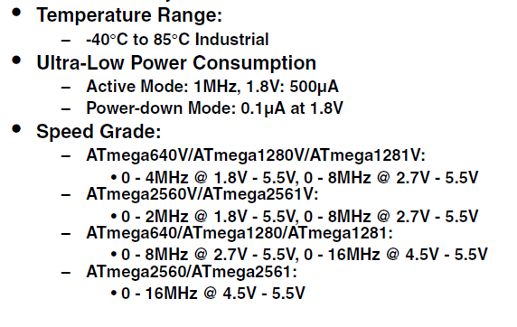
Datasheet

Slide 6
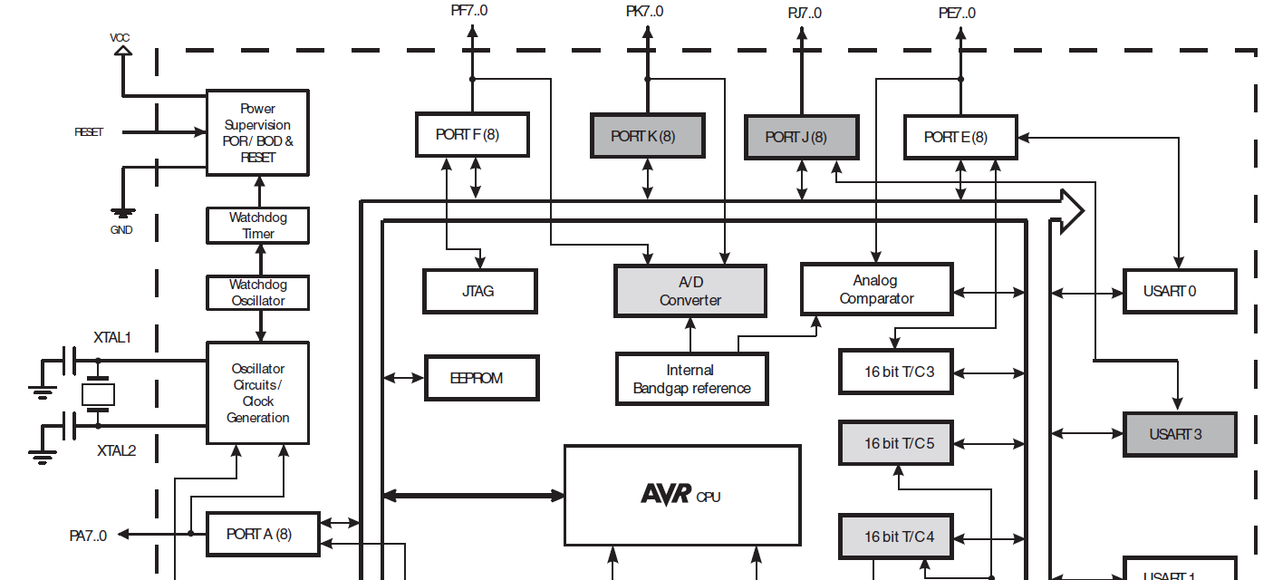

Slide 7
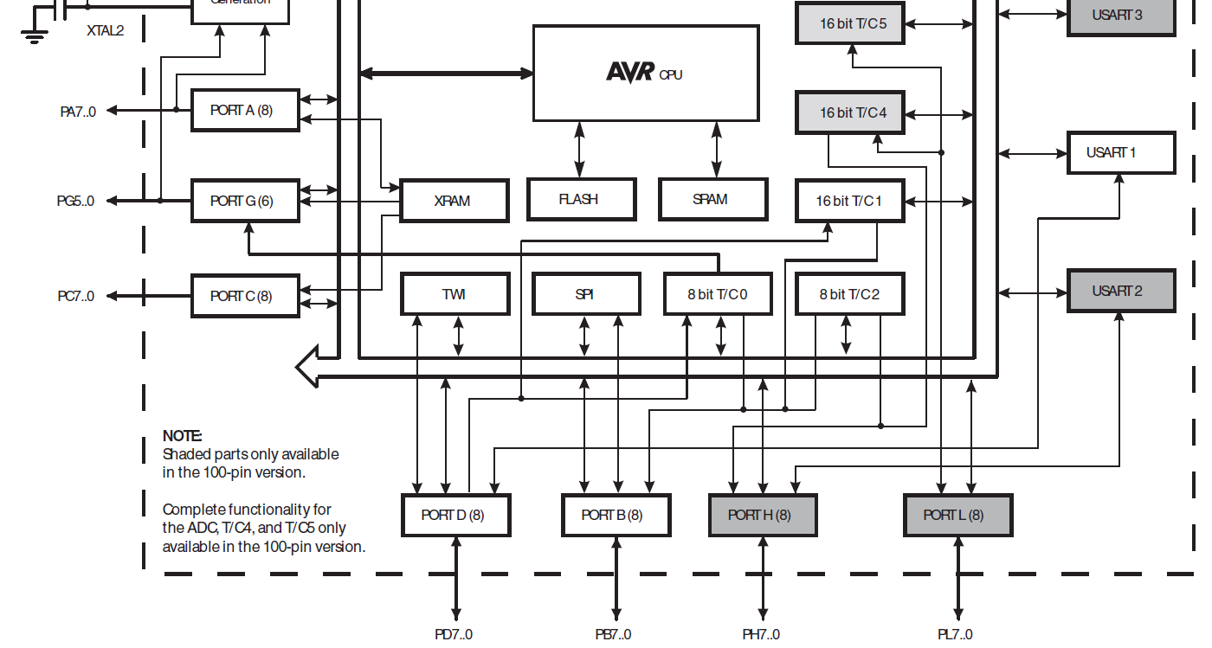

Slide 8
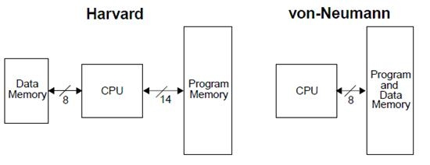

Slide 9
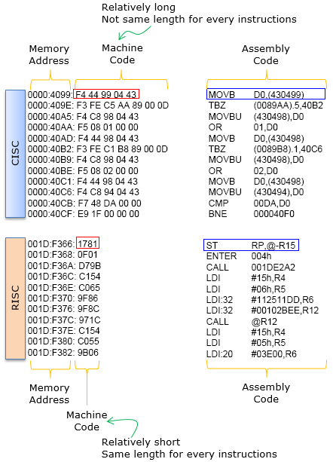
CISC vs RISC
CISC – Complex Instruction Set Computer
RISC – Reduced Instruction Set Computer

Slide 10
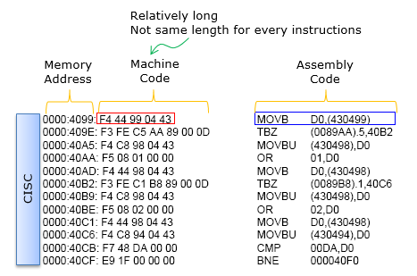

Slide 11
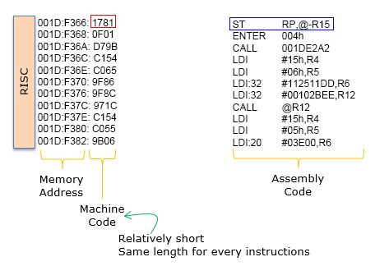

Slide 12
MIPS (Millions of Instructions Per Second)

